Slide 1
AADL & AGREE

Slide 2
AADL Overview
See “AADL V2 Overview Feb 2010” available at: https://wiki.sei.cmu.edu/aadl/images/7/73/AADLV2Overview-AADLUserDay-Feb_2010.pdf

Slide 3
Analysis Using AADL
This is really the point of using the notation!
The following slides are based on “Embedded System Architecture Analysis Using SAE AADL” by Feiler, Gluch, Hudak, and Lewis.
Available at: http://resources.sei.cmu.edu/library/asset-view.cfm?assetid=6881

Slide 4
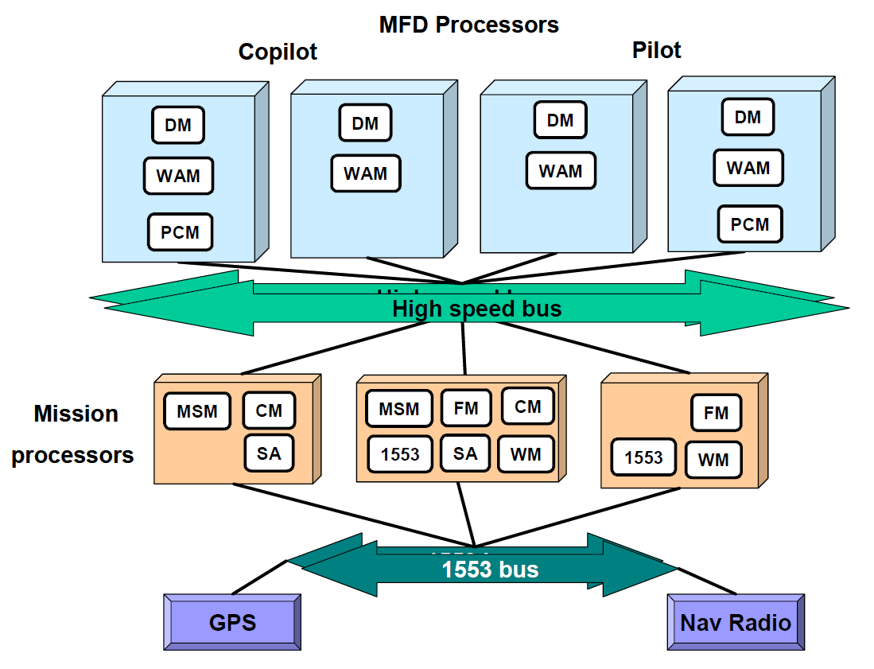
An Example:
MFD Hosted:
DM: MFD Display Manager
WAM: Warning and Annunciations Manager
PCM: Page Content and Menu Manager
FD: Flight Director
Mission Hosted:
CM: Communications Manager
WM: Weapons Manager
SA: Situational Awareness
FM: Flight Manager
MSM: Mission Sensor Manager
1553: Software Interface to MIL STD 1553 bus
Image from “Embedded System Architecture Analysis Using SAE AADL” by Feiler, Gluch, Hudak, and Lewis.
Notes:
MFD Hosted:
DM: MFD Display Manager
WAM: Warning and Annunciations Manager
PCM: Page Content and Menu Manager
FD: Flight Director
Mission Hosted:
CM: Communications Manager
WM: Weapons Manager
SA: Situational Awareness
FM: Flight Manager
MSM: Mission Sensor Manager
1553: Software Interface to MIL STD 1553 bus
Are DM’s redundant or do they contain separate functionality

Slide 5
An Example:
Are DMs , WAMs, etc. , redundant or unique?
MFD Hosted:
DM: MFD Display Manager
WAM: Warning and Annunciations Manager
PCM: Page Content and Menu Manager
FD: Flight Director
Mission Hosted:
CM: Communications Manager
WM: Weapons Manager
SA: Situational Awareness
FM: Flight Manager
MSM: Mission Sensor Manager
1553: Software Interface to MIL STD 1553 bus
How is data replicated between redundant mission processors and MFD processors
What are the delays of certain signal paths?
Image from “Embedded System Architecture Analysis Using SAE AADL” by Feiler, Gluch, Hudak, and Lewis.
Notes:
MFD Hosted:
DM: MFD Display Manager
WAM: Warning and Annunciations Manager
PCM: Page Content and Menu Manager
FD: Flight Director
Mission Hosted:
CM: Communications Manager
WM: Weapons Manager
SA: Situational Awareness
FM: Flight Manager
MSM: Mission Sensor Manager
1553: Software Interface to MIL STD 1553 bus
Are DM’s redundant or do they contain separate functionality

Slide 6
Model in AADL to Clarify Architecture
AADL Allows straightforward, precise modeling of current system and possible changes to system
Can discuss schedulability, reliability, etc.
Can use built-in analyses to provide quantified information

Slide 7
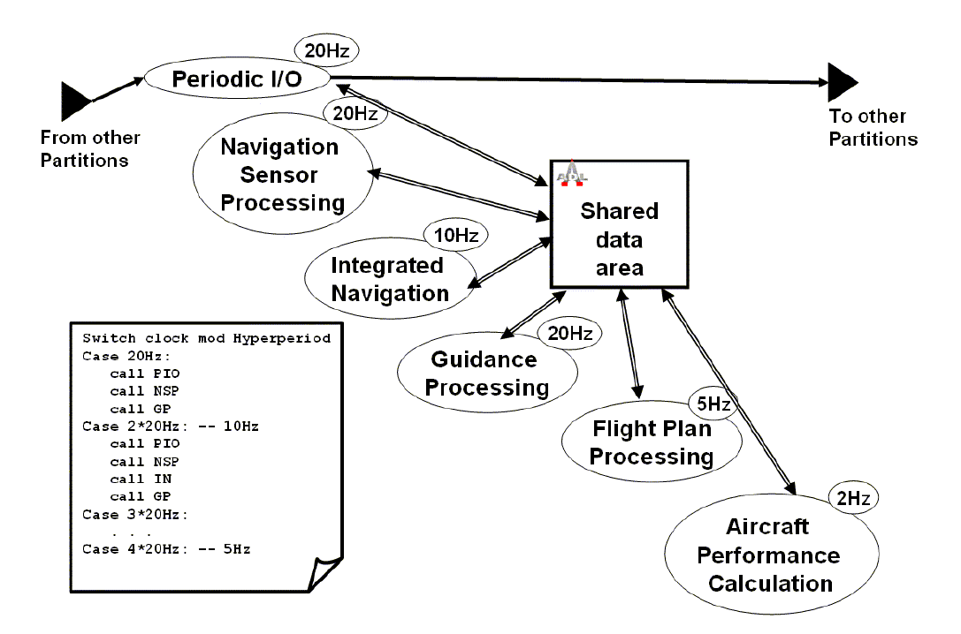
Initial Model:
Scheduling this “task” with others is difficult; it must run at 20Hz and worst case execution time is high
Image from “Embedded System Architecture Analysis Using SAE AADL” by Feiler, Gluch, Hudak, and Lewis.
Notes:
Navigation and sensor processing: where did this model come from? “Embedded System Architecture Analysis Using AADL”
Why is scheduling difficult? It needs to finish quickly (in a 20Hz slot) so that the system can re-run NSP and GP, which have to run every 20 Hz.

Slide 8
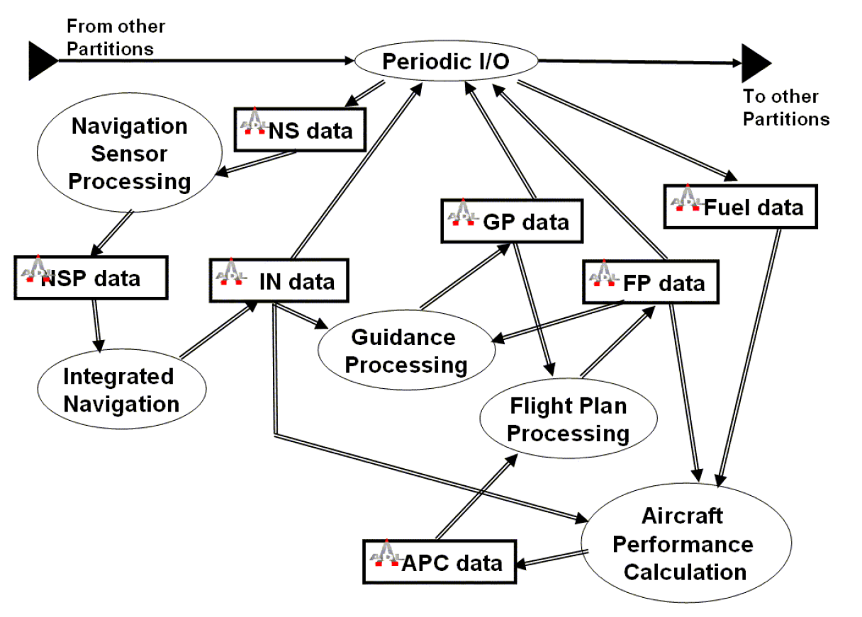
Flow Communication
Image from “Embedded System Architecture Analysis Using SAE AADL” by Feiler, Gluch, Hudak, and Lewis.
Notes:
Flow communication model. Step 1: break up the shared data area to properly understand information flow through the system.

Slide 9
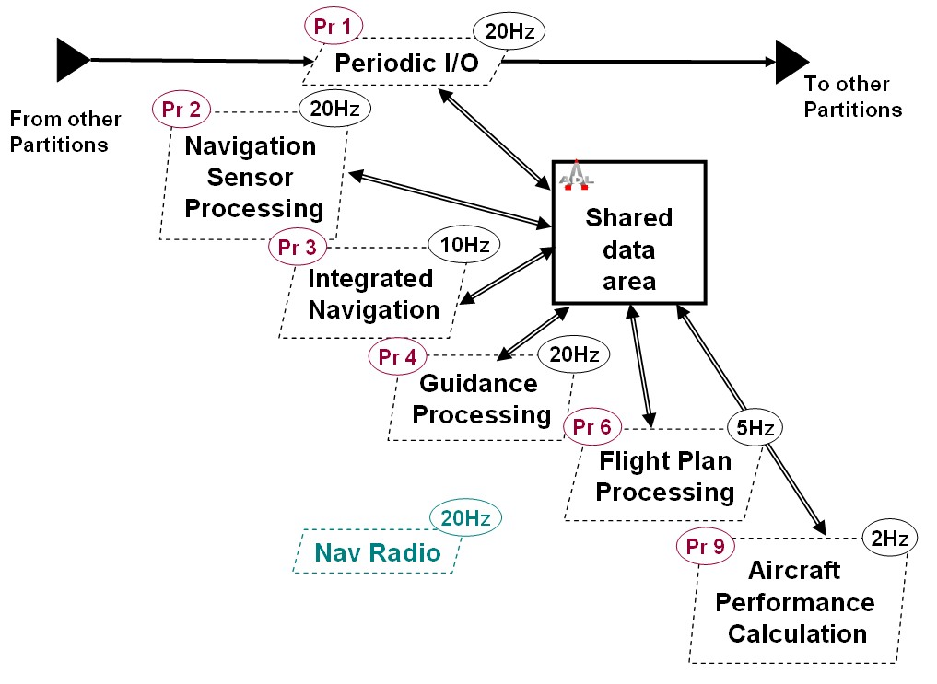
A Priority-Based Approach
Priority inversion here.
PG *needs* to run more often than IN, but can’t pre-empt it. Difficult to schedule!
Representing data dependencies as priorities is a poor way to schedule tasks.
Image from “Embedded System Architecture Analysis Using SAE AADL” by Feiler, Gluch, Hudak, and Lewis.
Notes:
Step 2: attempt RMA scheduling.

Slide 10
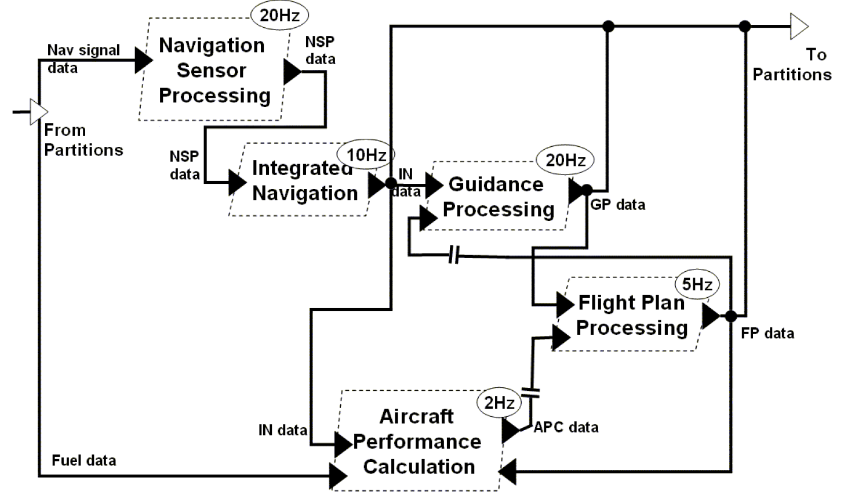
Dataflow-based scheduling
Flow-based analysis allows mid-frame dependencies added to schedule constraints. Represent problem directly and get better resource utilization.
Image from “Embedded System Architecture Analysis Using SAE AADL” by Feiler, Gluch, Hudak, and Lewis.

Slide 11
Polling or Event-Based?
Current system uses polling for all tasks
Polling processes allow simple scheduling algorithms
Maintains periodicity of threads to be scheduled
However, polling is very inefficient for certain tasks, like monitoring user interface elements
Switches, keyboard
Have to set polling rate high enough that no state change is missed.
Also want high rate to reduce latency
But most of the time, it does nothing.
But…events can cause missed deadlines

Slide 12
Sporadic events
AADL allows scheduling of sporadic events
Specified minimum time between events
Efficiency gains:
Reduce number of concurrent monitors of events (not all buttons can be pressed at once)
If event processing is not a “hard” real time problem, possible to gain further utilization in scheduling

Slide 13
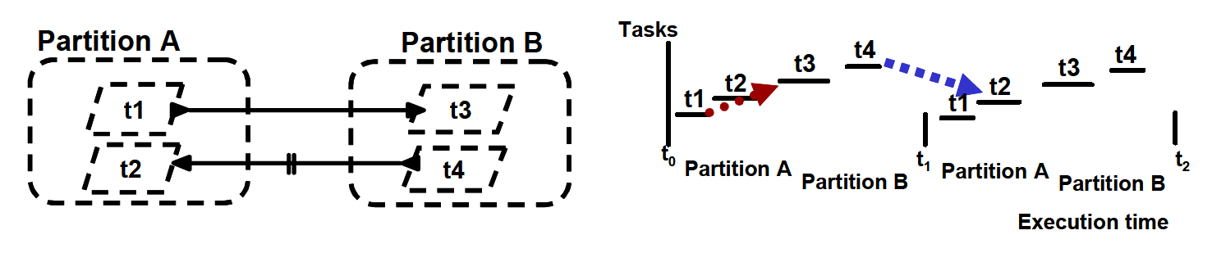
Managing Latency
Flow-based analysis allows mid-frame dependencies added to schedule constraints to both threads and partitions.
Image from “Embedded System Architecture Analysis Using SAE AADL” by Feiler, Gluch, Hudak, and Lewis.

Slide 14
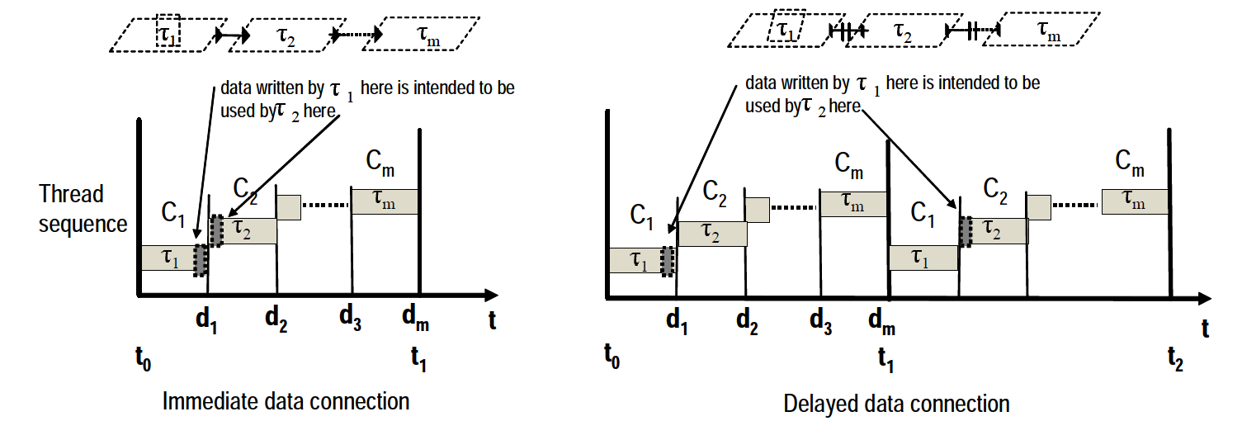
Managing Latency
Immediate connections allow lower-latency connections between threads
If threads communicate bi-directionally, one connection must be delayed.
Image from “Embedded System Architecture Analysis Using SAE AADL” by Feiler, Gluch, Hudak, and Lewis.

Slide 15
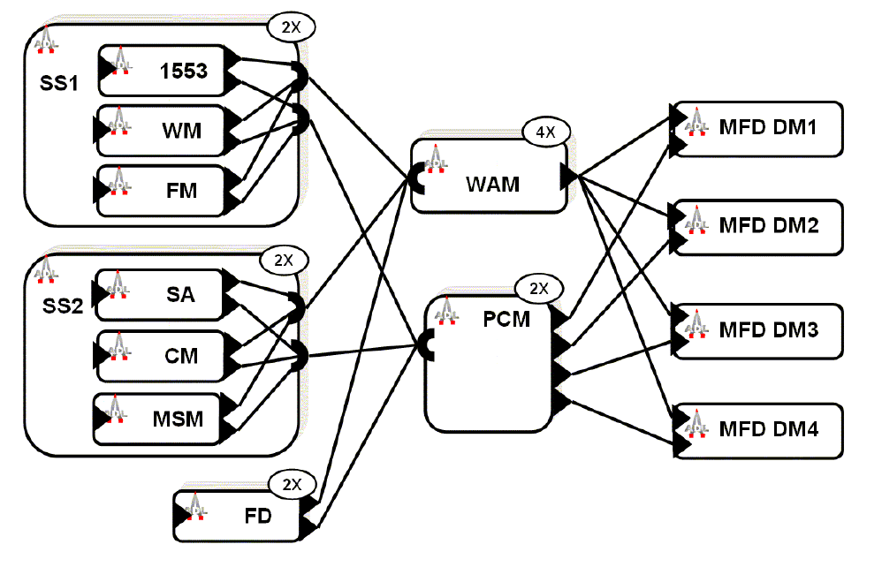
Communicating Redundancy
Image from “Embedded System Architecture Analysis Using SAE AADL” by Feiler, Gluch, Hudak, and Lewis.

Slide 16
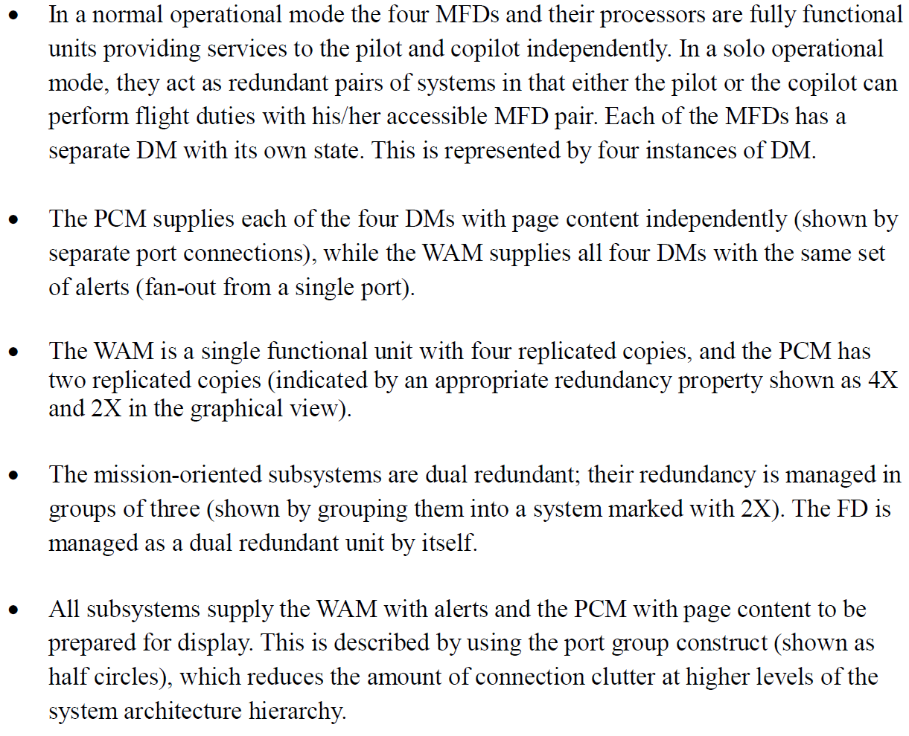
Communicating Redundancy

Slide 17
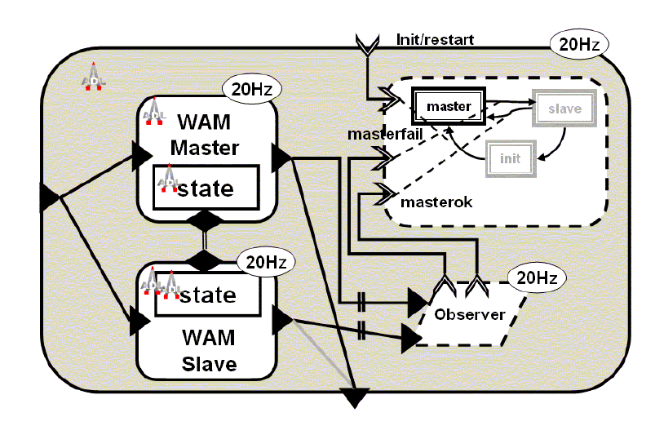
Describing Fault Tolerance
Image from “Embedded System Architecture Analysis Using SAE AADL” by Feiler, Gluch, Hudak, and Lewis.

Slide 18
Compositional verification

Slide 19
Main Messages
Scaling formal verification up to system architectures requires compositional approaches.
Compositional approaches require both logical foundations and engineering support.
Your How is My What: in large-scale systems, requirements vs. design is a often matter of perspective
Notes:
What is the point of my talk?
- Your how is my what.

Slide 20
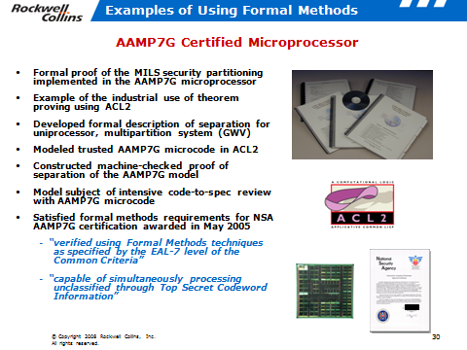
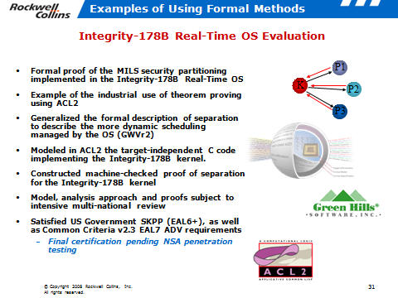
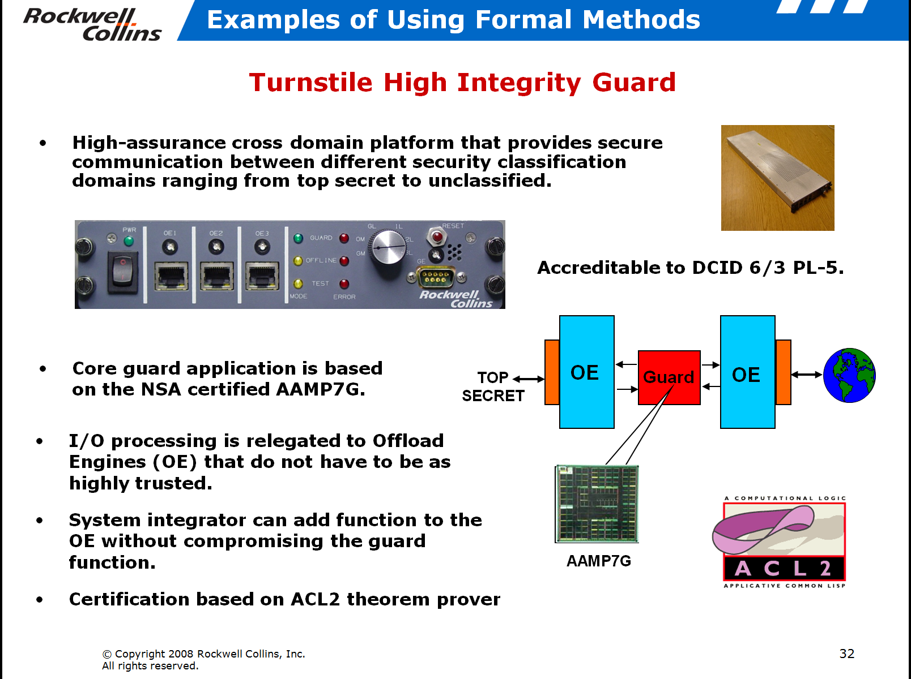

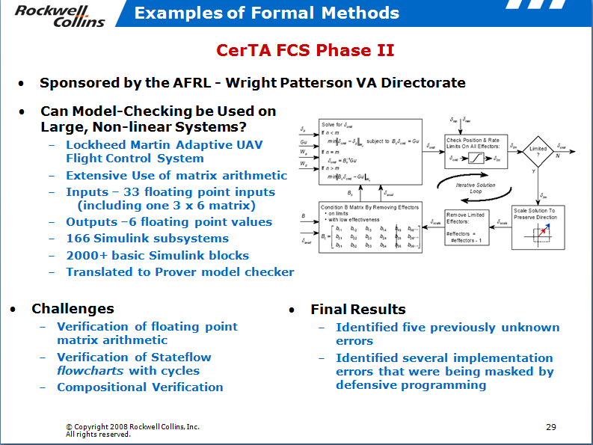
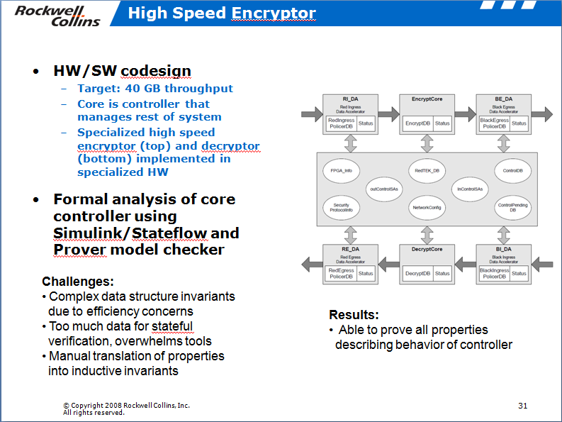
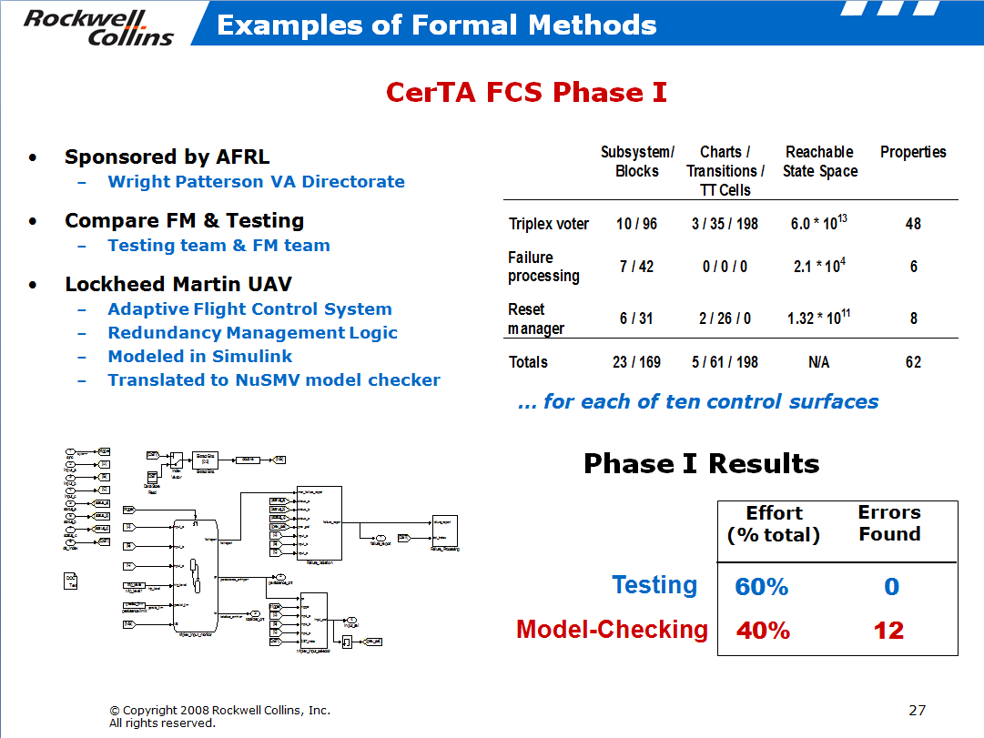
Component Level Formal Analysis Efforts
Notes:
Note: not a one man show! Collins continues to use this technology.

Slide 21



Slide 22
System verification
SPECIFICATION
SYSTEM DEVELOPMENT
FOUNDRY
INSTANTIATE ARCHITECTURAL PATTERNS
ARCH PATTERN MODELS
ANNOTATE
& VERIFY MODELS
PATTERN & COMP SPEC
LIBRARY
SYSTEM MODELING ENVIRONMENT
SYSTEM MODEL
AUTO
GENERATE
SYSTEM IMPLEMENTATION
COMPONENT MODELS
COMPONENT
LIBRARY
COMPOSITIONAL REASONING & ANALYSIS
Reusable Verification:
Proof of component and pattern requirements (guarantees) and specification of context (assumptions)
Instantiation:
Check structural constraints, Embed assumptions & guarantees in system model
Compositional Verification:
System properties are verified by model checking using component & pattern contracts
© Copyright 2011 Rockwell Collins, Inc.
All rights reserved.

Slide 23
Hierarchical reasoning about systems
Avionics system requirement
Relies upon
Accuracy of air data sensors
Control commands from FCS
Mode of FGS
FGS control law behavior
Failover behavior between FGS systems
….
Response of Actuators
Timing/Lag/Latency of Communications
Avionics
System
Under single-fault assumption, GC output transient response is bounded in time and magnitude
ADS_L
ADS_R
FCS
…
FGS_L
FGS_R
Autopilot
…
System Modes
Control Laws
Co-ord

Slide 24
Compositional Reasoning for Active Standby
Want to prove a transient response property
The autopilot will not cause a sharp change in pitch of aircraft.
Even when one FGS fails and the other assumes control
Given assumptions about the environment
The sensed aircraft pitch from the air data system is within some absolute bound and doesn’t change too quickly
The discrepancy in sensed pitch between left and right side sensors is bounded.
and guarantees provided by components
When a FGS is active, it will generate an acceptable pitch rate
As well as facts provided by pattern application
Leader selection: at least one FGS will always be active (modulo one “failover” step)
transient_response_1 : assert true -> abs(CSA.CSA_Pitch_Delta) < CSA_MAX_PITCH_DELTA ;
transient_response_2 : assert true -> abs(CSA.CSA_Pitch_Delta - prev(CSA.CSA_Pitch_Delta, 0.0)) < CSA_MAX_PITCH_DELTA_STEP ;

Slide 25
Hierarchical reasoning between analysis domains.
NASA Project
Flight Control
System
Avionics system requirement
Relies upon
Guarantees provided by patterns and components
Structural properties of model
Resource allocation feasibility
Probabilistic system-level failure characteristics
Under single-fault assumption, GC output transient response is bounded in time and magnitude
Behavior
leader transition
managed on failure
Leader Selection
synchronous
communication
one node
operational
SMACCM Project
PALS
Replication
GUARANTEES
ASSUMPTIONS
Structure
timing
constraints
not
co-located
Platform
Principled mechanism for “passing the buck”
Resource
Probabilistic
RT sched
& latency
Error
model
© Copyright 2011 Rockwell Collins, Inc.
All rights reserved.

Slide 26
Contracts
Derived from Property Specification Language (PSL) formalism
IEEE standard
In wide use for hardware verification
Assume / Guarantee style specification
Assumptions: “Under these conditions”
Promises (Guarantees): “…the system will do X”
Local definitions can be created to simplify properties
Contract:
fun abs(x: real) : real = if (x > 0) then x else -x ;
const ADS_MAX_PITCH_DELTA: real = 3.0 ;
const FCS_MAX_PITCH_SIDE_DELTA: real = 2.0 ;
const CSA_MAX_PITCH_DELTA: real = 5.0 ;
const CSA_MAX_PITCH_DELTA_STEP: real = 5.0 ;
property AD_L_Pitch_Step_Delta_Valid =
true -> abs(AD_L.pitch.val - prev(AD_L.pitch.val, 0.0)) < ADS_MAX_PITCH_DELTA ;
property AD_R_Pitch_Step_Delta_Valid =
true -> abs(AD_R.pitch.val - prev(AD_R.pitch.val, 0.0)) < ADS_MAX_PITCH_DELTA ;
property Pitch_lr_ok =
abs(AD_L.pitch.val - AD_R.pitch.val) < FCS_MAX_PITCH_SIDE_DELTA ;
property some_fgs_active =
(FD_L.mds.active or FD_R.mds.active) ;
active_assumption: assume some_fgs_active ;
transient_assumption :
assume AD_L_Pitch_Step_Delta_Valid and
AD_R_Pitch_Step_Delta_Valid and Pitch_lr_ok ;
transient_response_1 :
assert true -> abs(CSA.CSA_Pitch_Delta) < CSA_MAX_PITCH_DELTA ;
transient_response_2 :
assert true -> abs(CSA.CSA_Pitch_Delta - prev(CSA.CSA_Pitch_Delta, 0.0)) < CSA_MAX_PITCH_DELTA_STEP ;
© Copyright 2011 Rockwell Collins, Inc.
All rights reserved.

Slide 27
Reasoning about contracts
Notionally: It is always the case that if the component assumption is true, then the component will ensure that the guarantee is true.
G(A ⇒ P);
An assumption violation in the past may prevent component from satisfying current guarantee, so we need to assert that the assumptions are true up to the current step:
G(H(A) ⇒ P) ;

Slide 28
Systems of Contracts
Architectures are hierarchically composed in layers.
Visually: a box and line diagram
Formally you can view a layer as a system S: S = (A, P, C)
C is a finite set of component contracts C: ℙ (A x P)

Slide 29
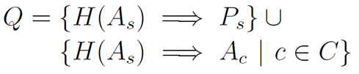
Reasoning about Contracts
Given the set of component contracts: Γ = { G(H(A_{c}) ⇒ P_{c}) | c ∈ C }
Architecture adds a set of obligations that tie the system assumption to the component assumptions
This process can be repeated for any number of abstraction levels

Slide 30
Circular Systems
It is often the case that components communicate bi-directionally.
This can translate into mutual dependencies between components
How do we reason when component assumptions circularly rely on guarantees of other components?

Slide 31
Reasoning Soundly with Circular Components
Ken McMillan described sound approach for reasoning about circular systems based on induction
Idea: break circularity using time.
Given {A, B}, if assumptions for A rely on guarantees for B in current time step, then assumptions for B can only reference guarantees for A up to previous time step.

Slide 32
Handling Circularity, Formally
Define a well-founded order (<) on components
A < B means that B can refer to A’s guarantees in the current time step
Otherwise, B can only refer to A’s guarantee in previous time steps
By well-foundedness: If A < B, then B ≮ A
Now we can describe components that rely on one another in a circular fashion

Slide 33
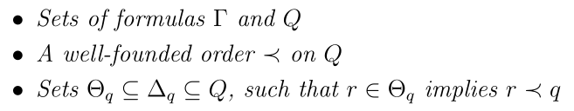
Composition Formulation
Suppose we have
Then if for all q ∈ Q
Γ ⇒ G((Z(H(Δ_{q})) ^ Θ_{q}) ⇒ q)
Then: G(q) for all q ∈ Q
[Adapted from McMillan]

Slide 34
A concrete example
Order of data flow through system components is computed by reasoning engine
{System inputs} → {FGS_L, FGS_R}
{FGS_L, FGS_R} → {AP}
{AP} → {System outputs}
Based on flow, we establish four proof obligations
System assumptions → FGS_L assumptions
System assumptions → FGS_R assumptions
System assumptions + FGS_L guarantees + FGS_R guarantees → AP assumptions
System assumptions + {FGS_L, FGS_R, AP} guarantees → System guarantees
System can also handle circular flows, but user has to choose where to break cycle

Slide 35
Let’s try it out
A
C
Assumption: Input < 20
Guarantee: Output < 2*Input
Assumption: none
Guarantee: Output = Input1 + Input2
B
Assumption: Input < 10
Guarantee: Output < 50
Assumption: Input < 20
Guarantee: Output < Input + 15
Is the system level output guarantee true?
How would you reason about this?
Model at: models/Toy_Example

Slide 36
DEMO
GPCA
Quad FCS

Slide 37
Architecture and Requirements

Slide 38
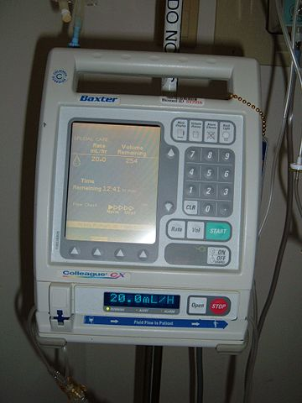
Requirements or Design Information?
The patient shall never be infused with a single air bubble more than 0.5ml volume.
When a single air bubble more than 0.5ml volume is detected, the system shall stop infusion within 0. 1 seconds.
When a single air bubble more than 0.5ml volume is detected, the system shall issue an air-embolism command.
When air-embolism command is true, the system shall stop infusion.
When a pump-stop command is received, the system shall stop piston movement within 0.01 second.

Slide 39
A: Both
The patient shall never be infused with a single air bubble more than 0.5ml volume.
When a single air bubble more than 0.5ml volume is detected, the system shall issue an air-embolism command.
PATIENT THERAPY SYSTEM
INFUSION SYSTEM
DRUG DELIVERY HARDWARE
AIR BUBBLE SENSOR
When air-embolism command is true, the system shall stop infusion.
PUMP SYSTEM
PUMP HARDWARE
PUMP CONTROLLER
When a pump-stop command is received, the system shall stop piston movement within 0.1 seconds
When a single air bubble more than 0.5ml volume is detected, the system shall stop infusion within 0.1 seconds.

Slide 40
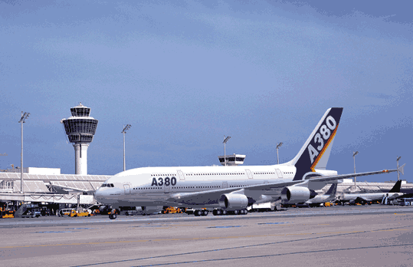

Slide 41
Your How is My What
Systems are hierarchically organized
Requirements vs. architectural design must be a matter of perspective
Need better support for N-level decompositions for requirements and architectural design
Reference model support
How do elements “flow” between world, machine, and specification as we decompose systems?
Certification standard support (DO-178B/C)
Currently: two levels of decomposition: “high” and “low”

Slide 42
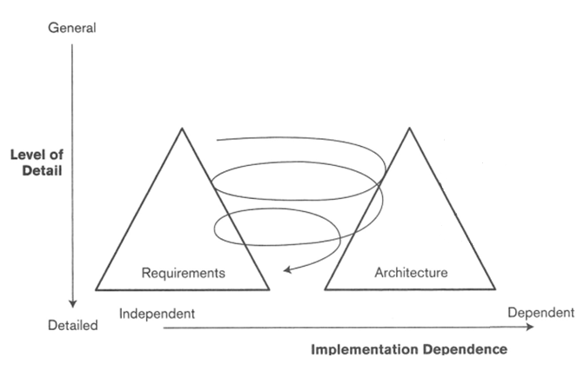
Twin Peaks

Slide 43
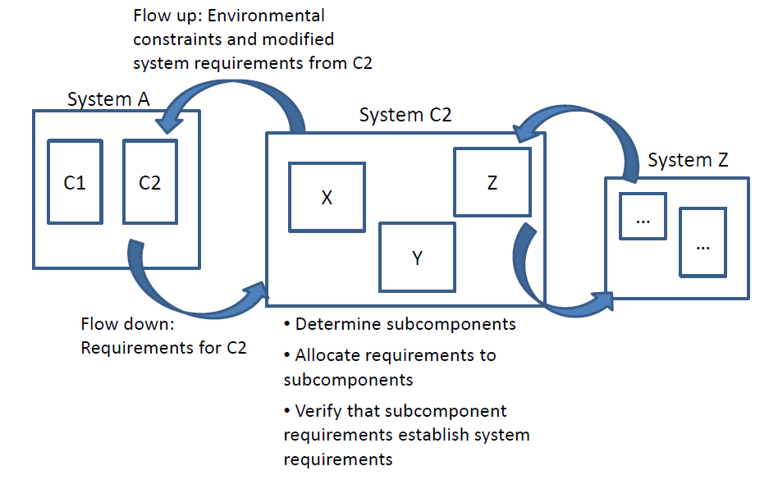
Flow is Bi-directional

Slide 44
Requirements Validation and Verification
Given hierarchical systems, where are the most serious problems with requirements?
At the component level?
At the top-level?
Somewhere in the middle?
A hypothesis:
The most problematic are the layers in the middle
Errors in decomposing system requirements become integration problems.
These are requirements to be both verified and validated.

Slide 45
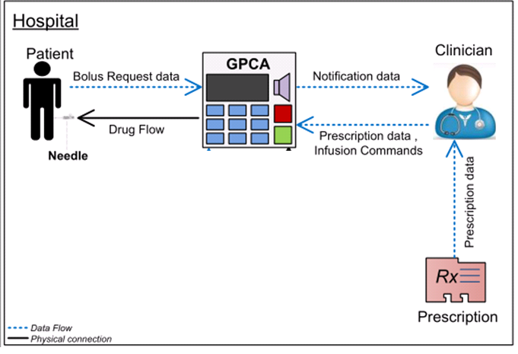
Requirements at different scopes
Patient-requested bolus shall not be delivered more often than a prescribed number of minutes
An upstream occlusion alarm shall be triggered if the system senses an upstream occlusion.
When the option to suspend the pump is selected, the current pump stroke shall be completed prior to suspending the pump
Notes:
The requirements were at multiple scopes…. It was first of all confusing and also difficult to maintain intellectual control over what we are trying to write requirements over…
So we decided that we need to first set a clear scope to state requirements…However it wasn’t trivial to decide on a boundary… We took a modeling approach to visualize the system scope

Slide 46
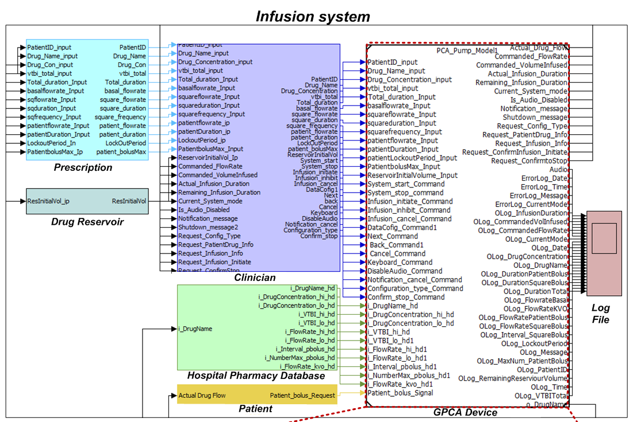
Architectural Models - System scope
Patient-requested bolus shall not be delivered more often than a prescribed number of minutes
Notes:
Now if we take each requirement…
For example the first requirement…talks about the prescription and patient.. But…

Slide 47

Architectural Models - System scope
Actual_
FlowRate_
ToPatient
Entered_Bolus_
FlowRate
Entered_Bolus_
Interval
Patient_bolus
Patient-requested bolus shall not be delivered more often than a prescribed number of minutes
The system shall not deliver Actual FlowRate_ToPatient at Entered_Bolus_FlowRate if duration between two consecutive Patient_bolus is less than Entered_Bolus_Interval
Notes:
So when we scoped the system to the device we were able to rewite the requirments in terms of the inputs and outputs of the system.
the reqrittent statement here is not an precise requirement statement but simplified to make it easy to understand the concept.

Slide 48
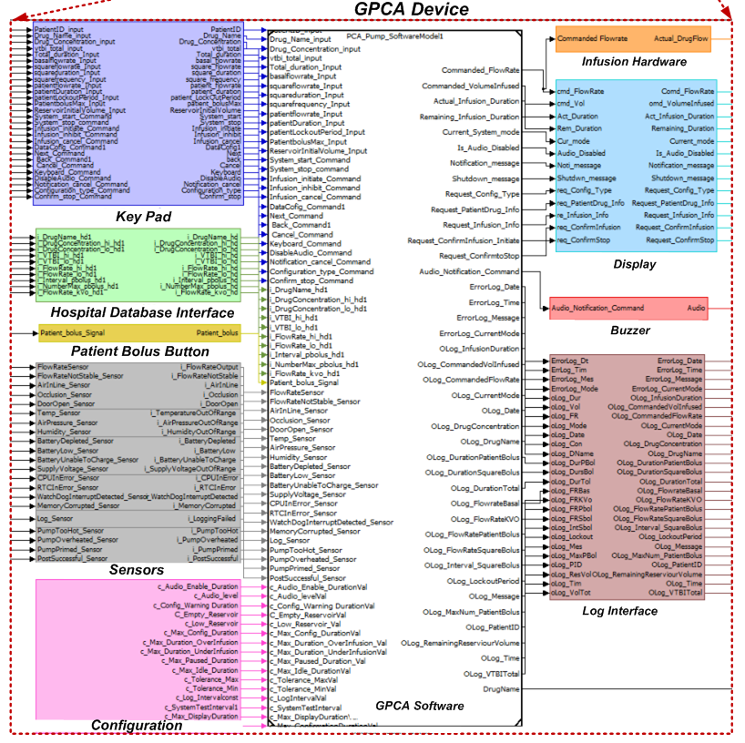
An upstream occlusion alarm shall be triggered if the system senses an upstream occlusion.
Notes:
Now when we had requirements about occlusion and raising alarm....

Slide 49
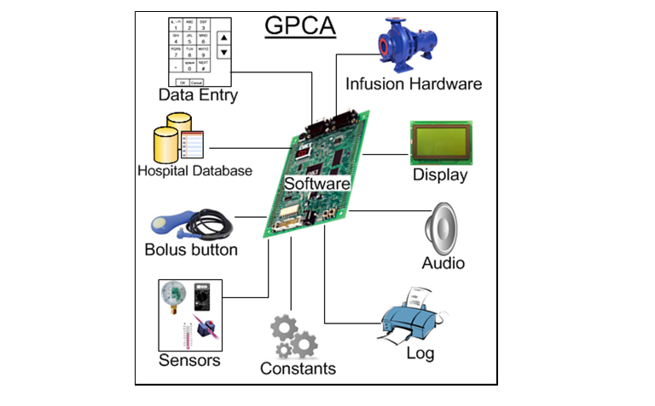
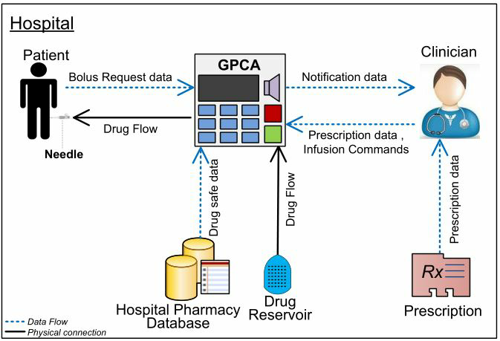
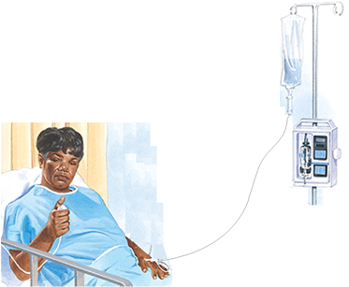
Case Example : Infusion system
Notes:
In our work, we were working on modeling a medical device – A generic Patient Controlled Analegesic Infusion Pump system.
Infusion pumps are medical devices used to accurately infuse liquids into a patient’s bloodstream – typically in hospitals.
Medical devices, such as infusion pumps, are suitable systems to explore since they are generally safety-critical and
the maturity level of the V&V process has often been insufficient to ensure the safety and overall quality of the devices.
In order to identify the purpose or requirement s of the system precisely, Defining the scope of the Infusion Pump was crucial.
Figure shows a GPCA device in a typical usage environment, a hospital. In this system,
The clinician operates the GPCA device - programs the prescription information, loads the drug etc
The patient receives the medication from the device through an intravenous needle.
The patient can self-administer prescribed amounts of additional
drug by requesting a bolus
The hospital pharmacy database is a repository that stores safe drug limits, typically provided by the manufacturer.
The infusion pump system is device that has both hardware and software components, For this exercise, we considered the software of the pump and we modeled it.

Slide 50
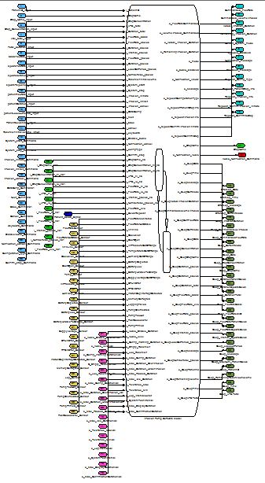
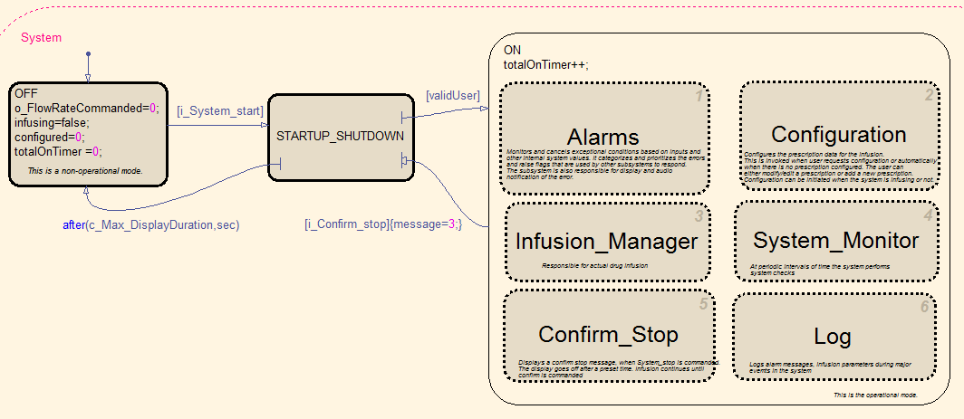
Monolithic Approach
Scalability
Complexity
Size
Notes:
We used Simulink/Stateflow to develop a model of the software.
As we were adding functionalities, we found that the overall complexity and size of the model was growing enormously. And as you might guess, verification was not scalable. We used Simulink’s design verifier and it timed out even after multiple attempts of increasing the timeout period.
This is when, we decided that we will not be able to have the software as a single model, but we needed a modular approach.

Slide 51
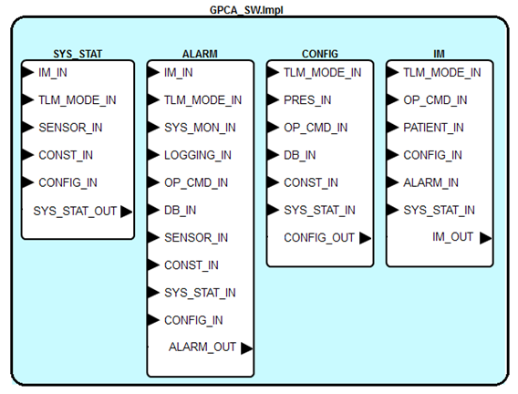

Software Decomposition
Notes:
Hence we designed an architecture for the software, in which we spilt the model into smaller manageable components.
In order to document, visualize, and analyze the architecture, it is desirable to have an architectural model that supports
descriptions of component interfaces, interconnections between components, and requirements on components, without describing the implementations of those components. The Architecture Analysis and Description Language (AADL) was our choice.
AADL by itself, does not have a built-in means of supporting reasoning about requirements.
However, we found that the software r
Using AGREE we can identify missing component contracts, improve them, or modify the system guarantees appropriately. This is powerful and scalable approach. However, this in itself is not complete. AGREE assumes that the component’s guarantees hold. However, we have not yet verified that the detailed behavior of a component indeed satisfies the component contract.
<CLICK> Lets see the refinement of an infusion pump in this closed loop system. The infusion pump properties used in the verification in AGREE constitute the requirements for the infusion pump. These system level requirements flowed-down as requirements on the various components of the pump, of particular interest here,
<CLICK > the software controlling the pump. Given the software requirements, we can model <CLICK > the detailed behavior of the software.
As we modeled the infusion pump software, we found that it is a complex system and has many requirements.

Slide 52
Requirements Allocation
While infusing,
if the total volume infused exceeds the maximum VTBI, then then system shall switch to KVO flow.
Computes total volume infused
Commands flow rate
Maintains thresholds
Raises alarms
Notes:
For example, let’s take one requirement allocated to the software. “While infusing, if the total volume infused exceeds the maximum volume to be infused (drug library), the system shall switch to KVO flow.”
When this requirement is flowed down, each component is allocated with its requirements, such as
<Click>
The SYSTEM STATUS Component computes the total volume infused; <Click>
The ALARM component raises a flag …say, a value 3…. if the volume infused is beyond a threshold; <Click>
The CONFIGURATION component maintains the threshold data<Click>
The INFUSION MANAGER component commands the flow rate of the drug based on the flag raised by ALARM.

Slide 53
AGREE Assume Guarantee Reasoning Environment
For a given system architecture, system level guarantees hold as a logical consequence of a given set of component-level guarantees and assumptions.
JKIND – a k-induction bounded model checker for verification
Architecture - expressed in the AADL
Assumptions and Guarantees - expressed in a subset a past-time temporal logic
Notes:
We use AGREE - Assume Guarantee Reasoning Environment - developed by Rockwell-Collins in partnership with University of Minnesota
AGREE uses JKIND – a k-induction bounded model checker for the verification. It verifies that for a given system architecture, system level guarantees hold as a logical consequence of a given set of component-level guarantees and assumptions.
In Agree, the architecture is expressed in the AADL and assumptions and guarantees are expressed in a subset a past-time temporal logic that has been defined as an annex of AADL.

Slide 54
Guarantees
While infusing,
if the total volume infused exceeds the maximum VTBI, then then system shall switch to KVO flow.
(pre(GPCA_SW_OUT.Current_System_Mode) > 1) and
(GPCA_SW_OUT.Volume_Infused > DB_IN.VTBI_High) ) =>
(GPCA_SW_OUT.Commanded_Flow_Rate <= GPCA_SW_OUT.Flow_Rate_KVO);
(IM_IN.Current_System_Mode > 1)) =>
SYS_STAT_OUT.In_Therapy);
(ALARM_IN.Highest_Level_Alarm = 3)) =>
(IM_OUT.Commanded_Flow_Rate = CONFIG_IN.Flow_Rate_KVO)
(SYS_STAT_IN.In_Therapy) and
(SYS_STAT_IN.Volume_Infused > DB_IN.VTBI_High ) ) =>
(ALARM_OUT.Highest_Level_Alarm >= 3) );
Notes:
For example, let’s take one requirement allocated to the software. “While infusing, if the total volume infused exceeds the maximum volume to be infused (drug library), the system shall switch to KVO flow.”
When this requirement is flowed down, each component is allocated with its requirements, such as
<Click>
The SYSTEM STATUS Component computes the total volume infused; <Click>
The ALARM component raises a flag …say, a value 3…. if the volume infused is beyond a threshold; <Click>
The CONFIGURATION component maintains the threshold data<Click>
The INFUSION MANAGER component commands the flow rate of the drug based on the flag raised by ALARM.

Slide 55
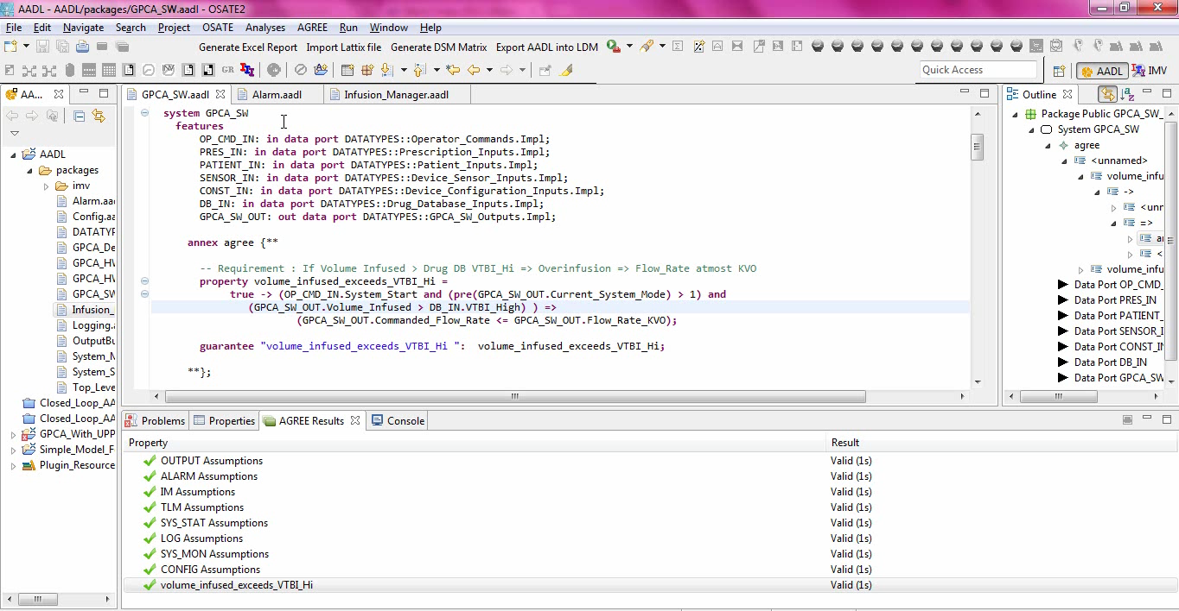
AGREE Demo
Notes:
In Agree, each of these system and component properties are formalized as Assumptions and Guarantees. Using AGREE, we can verify if the requirements allocated to each component is sufficient to guarantee the system level property. Lets look at a short demo of AGREE Verification.
Osate, an eclipse plugin for AADL is used for AGREE verification. As you can see on screen, the volume requirement at the system level is the one that needs to be guaranteed. <START DEMO NOW>
the Component GURANTEES are also formalized properties. For example, the ALARM component guarantees that it will raise an alarm of atleast level 3 if the volume threshold is reached.
Similarly, the infusion manager guarantees that it will not command a flow more than the KVO rate if it seems an level 3 alarm.
Now if we try to verify the system level guarantee using these component guarantees – we notice that the property verification failed.
AGREE provides us a counter example that helps us debug the issue. In this case, the alarm component has raised a level 5 alarm which is not handled by the infusion manager.
This shows that we need to restrict the alarm levels in the ALARM component and have related properties in the infusion manager.
According to our design we have only four levels of alarms and each of these have a corresponding flow property in the infusion manager.
With this new guarantee in the ALARM, we could now prove the system level property.
Hence using AGREE We can identify missing component contracts, improve them, or modify the system guarantees appropriately. This is powerful and scalable approach. However, this in itself is not complete.
AGREE assumes that the component’s guarantees hold. However, we have not yet verified that the detailed behavior of a component indeed satisfies the component contract.

Slide 56
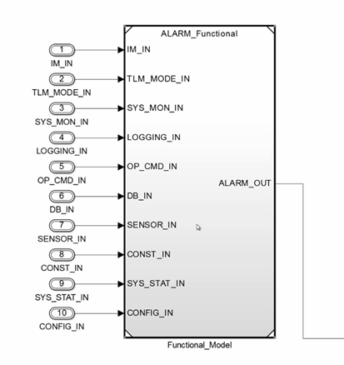
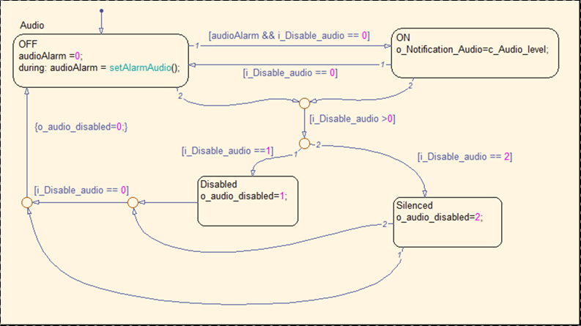
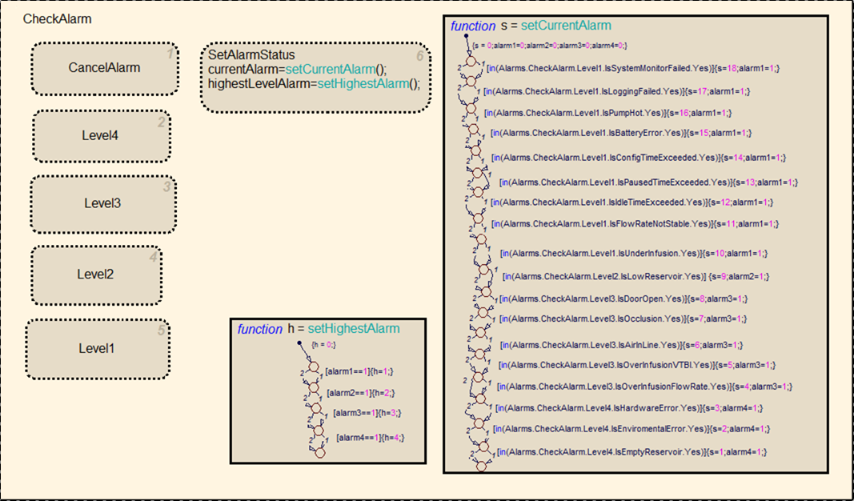
Behavioral Models
Notes:
Hence to verify if the behavior of these components indeed satisfy their requirements – we developed detailed behavioral models of each of these components using the monolithic software model as reference.
For example, the Alarm component's behavioral model is a hierarchical statemachine. <Click> <Click>
To verify that the behavior of these models satisfy their requirements – we used Design Verifier tool. It allows us to verify that the contracts derived in the previous AGREEE verification indeed are met by the behavioral models.
Since the component model is much lesser in scope as compared to the monolithic software model, verifying them wasn't a problem.

Slide 57
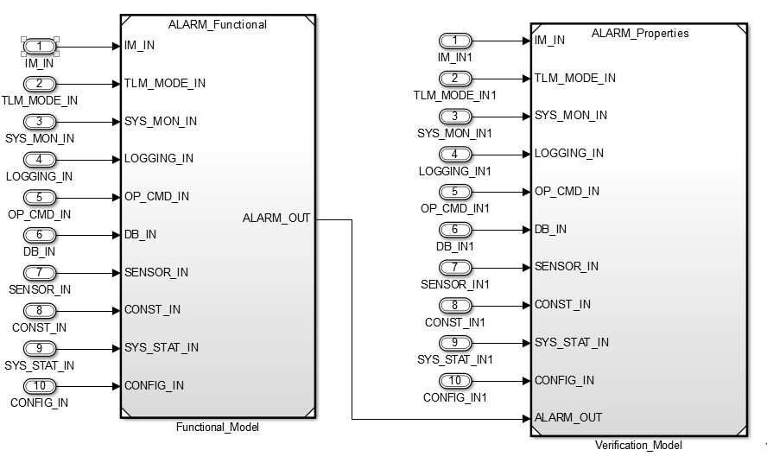
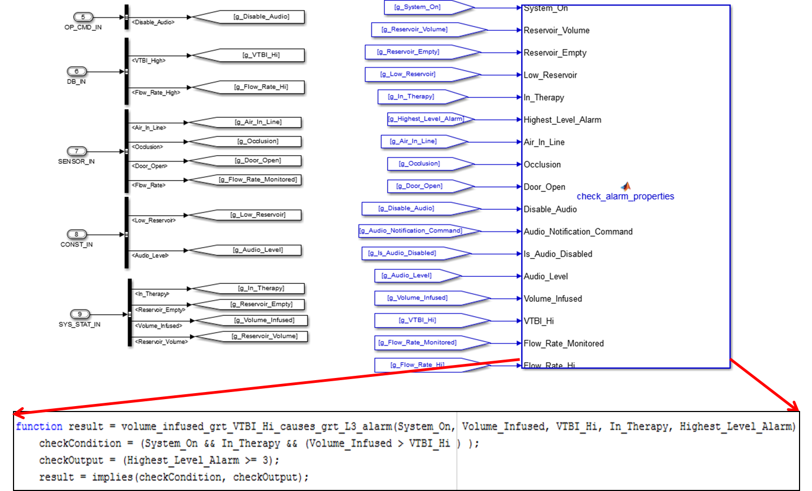
Verification Model
Notes:
The Design Verifier requires that the properties to be verified are captured as synchronous observers observing the execution of the model. To provide a clean and comprehensible integration of the behavioral model and the observers, we structured the models in such a way that the desired functionality of the system is captured in one “block” and the observer representing the requirements to be verified are specified in a property block. This structuring provides a clean separation between modeled behavior and the requirements, allowing the inevitable evolution of both.
This is the verification structuring for the ALARM model is Simulink. The functional model on the left references the developmental model and <click> the properties model on the right has the properties that needs to be verified.

Slide 58
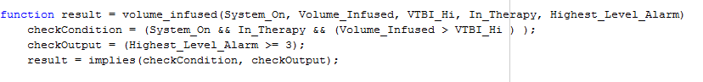
Property Correspondence
Property in AGREE
Property in Embedded Matlab
Notes:
A natural question to think about at this time is , how is the AGREE property correspond to the Behavioral model property???
As we already mentioned, the component properties in AGREE are expressed using a subset of past-time linear temporal logic.
However, The Simulink Design Verifier requires all properties to be specified as Boolean expressions in one of the available MATLAB notations.
In our work we have preferred using embedded MATLAB code since:
First of all , the property can be structured to closely resemble the natural language “shall” requirements in the
requirement document as well as the PLTL properties used in AGREE. This closeness in structure reduces the oppor-
tunities for transcription mistakes and makes the properties
easier to inspect. In the future, the translation between the
AGREE properties and the Design Verifier properties will be
automated.
Secondly in our experience the textual notations makes it easy to manage properties while verifications.
Let’s see a short demo of the volume property verification in the Design Verifier.

Slide 59
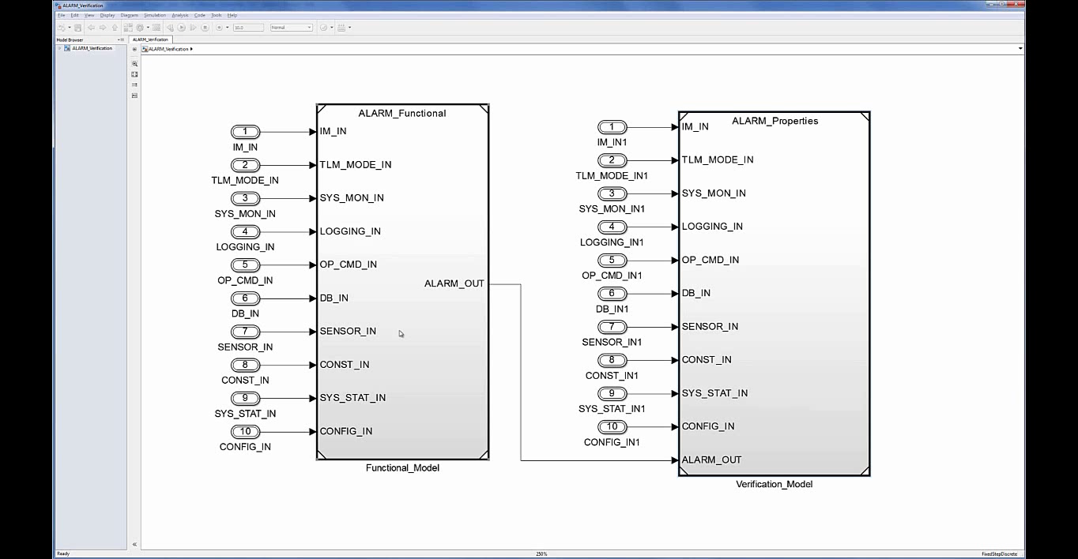
Behavioral Model Verification
Notes:
This is the verification model for the ALARM model that has the volume requirement formalized.
If we run analysis on the model to verify, as you can see –the alarm subsystem indeed satisfies its requirement.
Similarly, we can verify other component's properties.
If any of the property verification fails, the Design Verifier gives us counter example that helps replicate the scenario of failure.

Slide 60
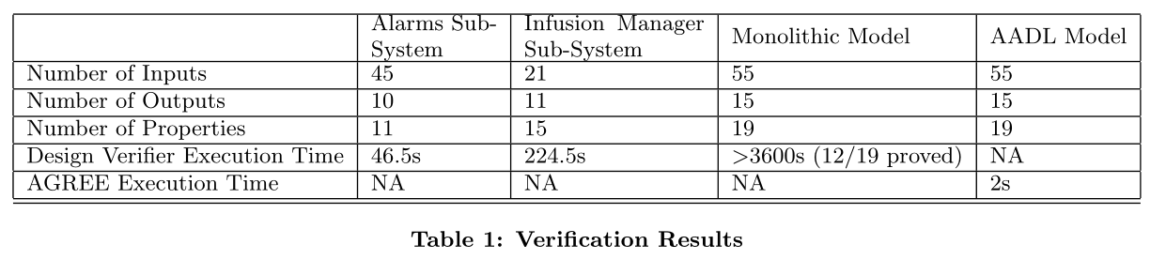
Results
Notes:
For the monolithic model, Simulink Design Verifier is unable to prove the current set of system-level properties within 60 minutes.
For the compositional approach, the total time required for analysis is slightly under 5 minutes .
Notably, the time required for the compositional portion of the analysis was only 2 seconds.

Slide 61
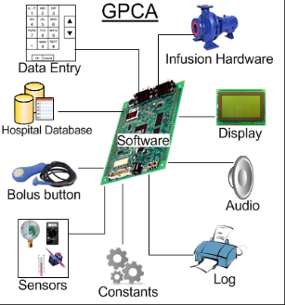
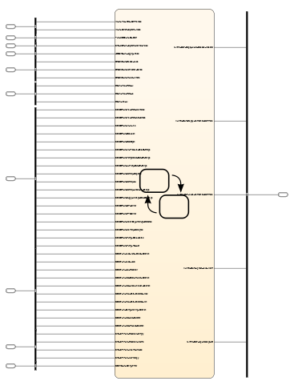
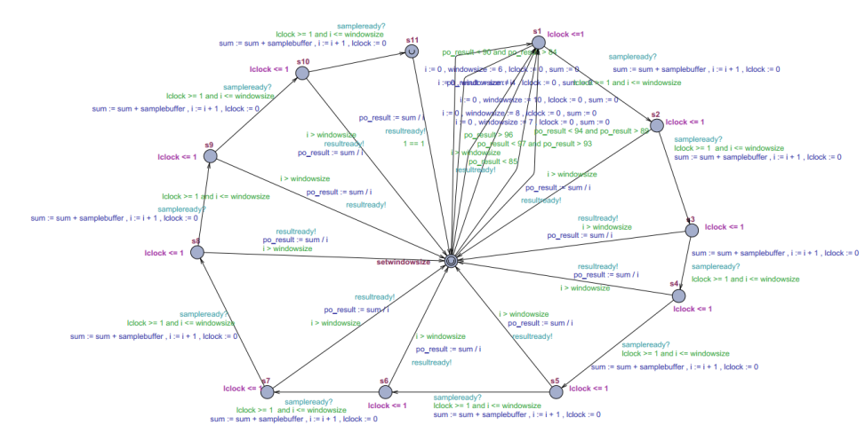
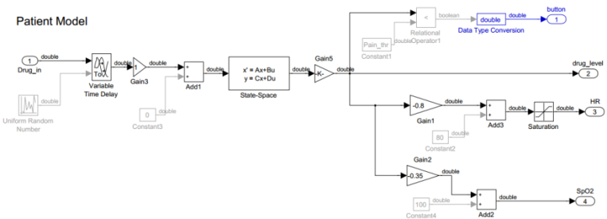
Summary
Notes:
To summarize, <CLICK> using the AGREE framework and Simulink/Stateflow with the design verifier, we were able to prove that the system level requirements are maintained as the system is hierarchically decomposed into components, the requirements are flowed down as component contracts, and the details of the lowest level components are modeled in a formal notation.
Instead of Stateflow, one may choose the most suitable technique for verifying if each component satisfies its guarantees, for example <CLICK> use the UPPAAL model-checker if the component is modeled as a timed-automata, or, a <CLICK> any other suitable modeling and verification approach..
We have described a scalable and practical approach to compositional verification using commonly used modeling notations and readily avail-
able tools.

Slide 62
Next Steps
Handle synchronous architectural models
Automated conversion of AGREE properties to Embedded Matlab properties.
Identify and address limitations of type of properties that can be verified.
Notes:
Should this be a conclusion slide or is this good enough? You can even skip this…

Slide 63
What have we learned?
You tell me!

Slide 64
What have we learned?
An overview of real-time architecture concepts
The role of time on application structure
How real-time concerns affect architecture partitioning
Logical/physical views of real-time systems
AADL and architecture description languages

